Slide 1
Basics of
Blogging
By Darshan Gajara
www.darshangajara.wordpress.com

Slide 2
What is Blogging?
Web Log = Blog
Getting yourself Online
Arts, Photography, Articles, Poems, Tech, etc

Slide 3
Why to Blog?
Sharing your thoughts
Influencing others
Write and Earn
Create your Identity without anybody’s reference

Slide 4
Write and Earn
Advertisements
Sponsored Articles
Business Publicity

Slide 5
Blog Service Providers
WordPress.com
WordPress.org
Blogger from Google
Tumblr.com
Dreamincode.net
Google up for the rest, there are endless Blog Service Providers

Slide 6
Technical Aspects
Content Management Systems (CMS)
Readymade Templates
Coding using HTML, CSS, Scipts, etc
Web Builders like Magento, Adobe Muse, Google Web Developer (Beta Version)

Slide 7
Top Bloggers in India
Sr No. | Blogger | Estimated Earnings/ Per month
1. | Amit Agarwal | ₹. 30,00,000
2. | Amit Bhawani | ₹. 7,00,000
3. | Harsh Agarwal | ₹. 3,50,000 - 4,50,000
4. | Srinivas Tamada | ₹. 2,00,000 – 3,50,000
5. | S. Pradeep Kumar | ₹. 3,00,000 – 3,50,000

Slide 8
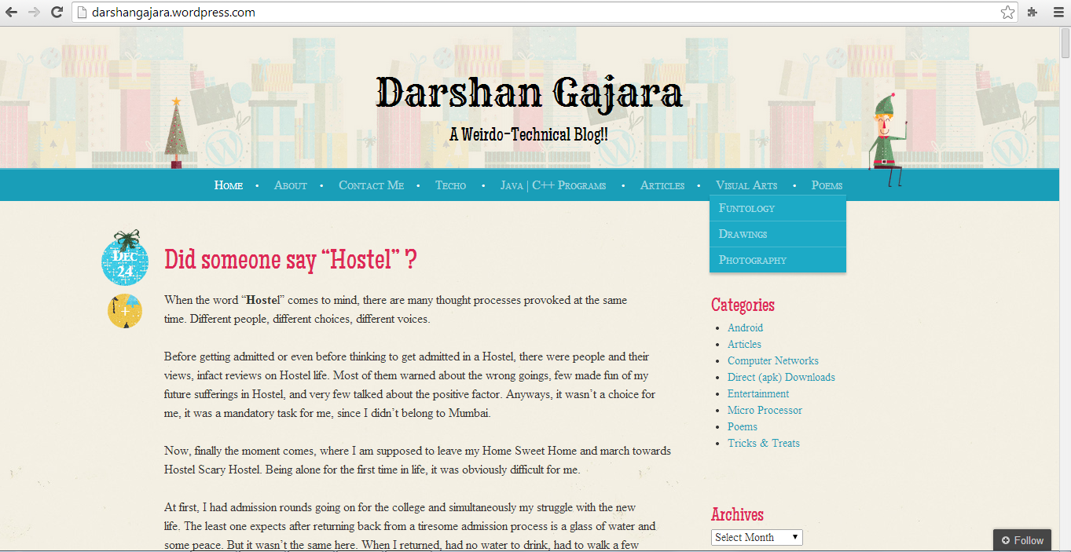
www.darshangajara.wordpress.com

Slide 9
Thanks a ton

