Slide 1
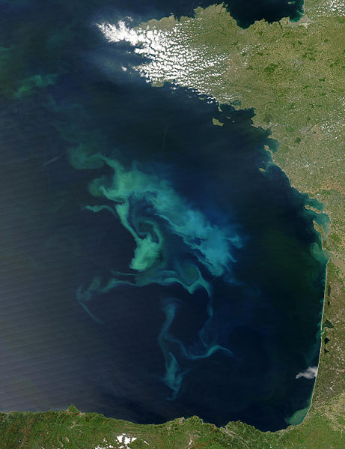
Geo engineering
Presented by :
Soumyabhusan Sasmal
Shweta Bhanushali
Sahil Shah

Slide 2

What is geoengineering ???
Geoengineering is the application of geosciences
An intentional large-scale manipulation of the environment.

Slide 3
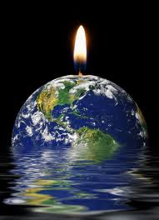
origination
Its was first proposed by “James Pollard Espy” the first meteorologist in 1830’s to control forest burning in order to stimulate rain.
Came in to practice during the cold war
In 1965 it was specifically mentioned as an option to mitigate the effects of climate change

Slide 4
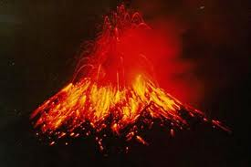
In 1991 A real world experiment played out with the volcanic eruption of Mount Pinatubo in the Philippines.
John Holdren, has personally come out in support of research into geoengineering options.

Slide 5

Need of geoengineering
concentration of carbon dioxide in the earth’s atmosphere recently surpassed 400 parts per million.
Relentlessly rising greenhouse-gas emissions.

Slide 6
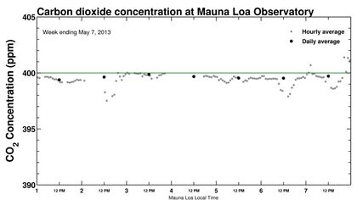


Slide 7
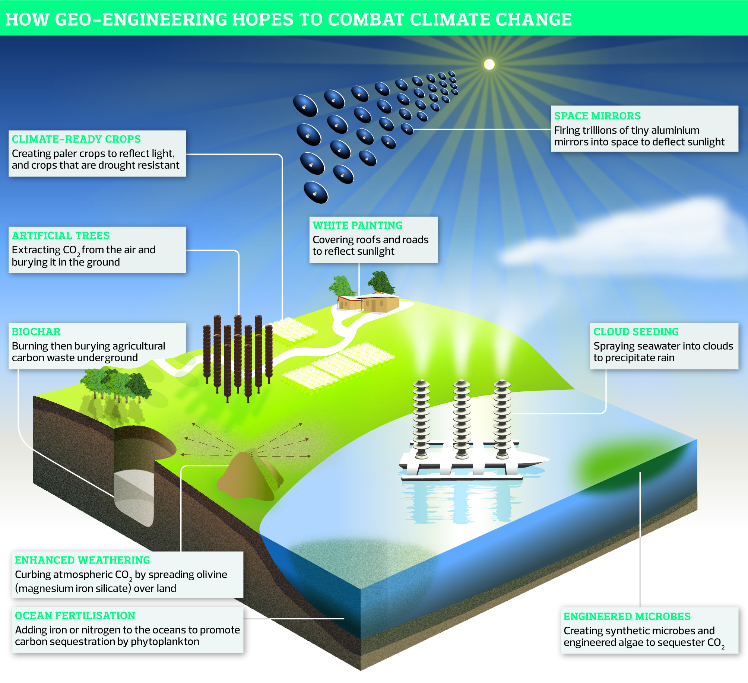
Geoengineering Schemes
Climate engineering
Solar Radiation Management
Carbondioxide Removal

Slide 8
What Is Carbon Sequestration ?
Also known as “carbon capture”
A geoengineering technique for the long-term storage of carbon dioxide (or other forms of carbon) for the mitigation of global warming
Ways that carbon can be stored (sequestered):
  In plants and soil “terrestrial sequestration” (“carbon sinks”)
  Underground “geological sequestration”
  Deep in ocean “ocean sequestration”
  As a solid material (still in development)

Slide 9
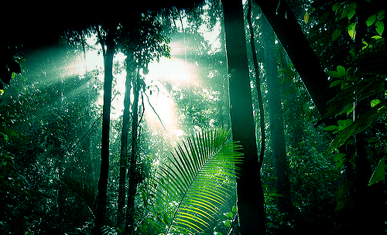
Terrestrial Carbon Sequestration

Slide 10
Terrestrial Carbon Sequestration
The process through which CO2 from the atmosphere is absorbed naturally through photosynthesis & stored as carbon in biomass & soils.
Tropical deforestation is responsible for 20% of world’s annual CO2 emissions.
Ways to reduce greenhouse gases:
  avoiding emissions by maintaining existing carbon storage in trees and soils
  increasing carbon storage by tree planting

Slide 11
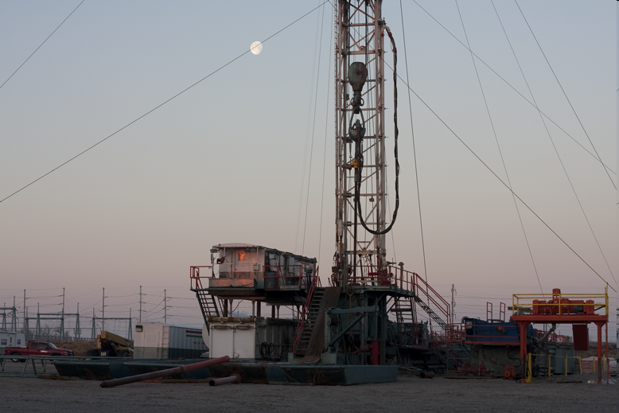
Geological Sequestration

Slide 12
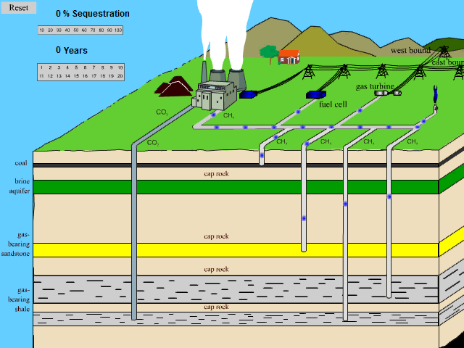
Geological Sequestration
Storing of CO2 underground in rock formations able to retain large amounts of CO2 over a long time period
  Held in small pore spaces (have held oil and nat. gas for millions of years)

Slide 13

Ocean Sequestration

Slide 14
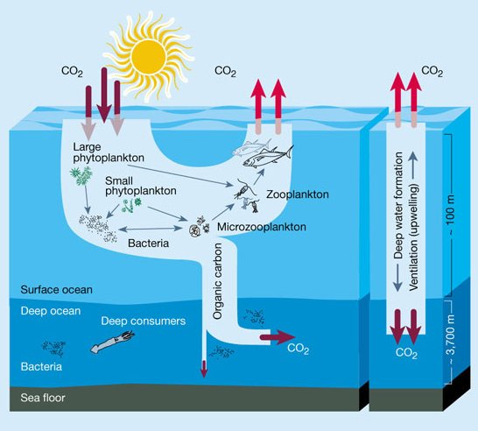
The Ocean and the “Biological Pump”

Slide 15
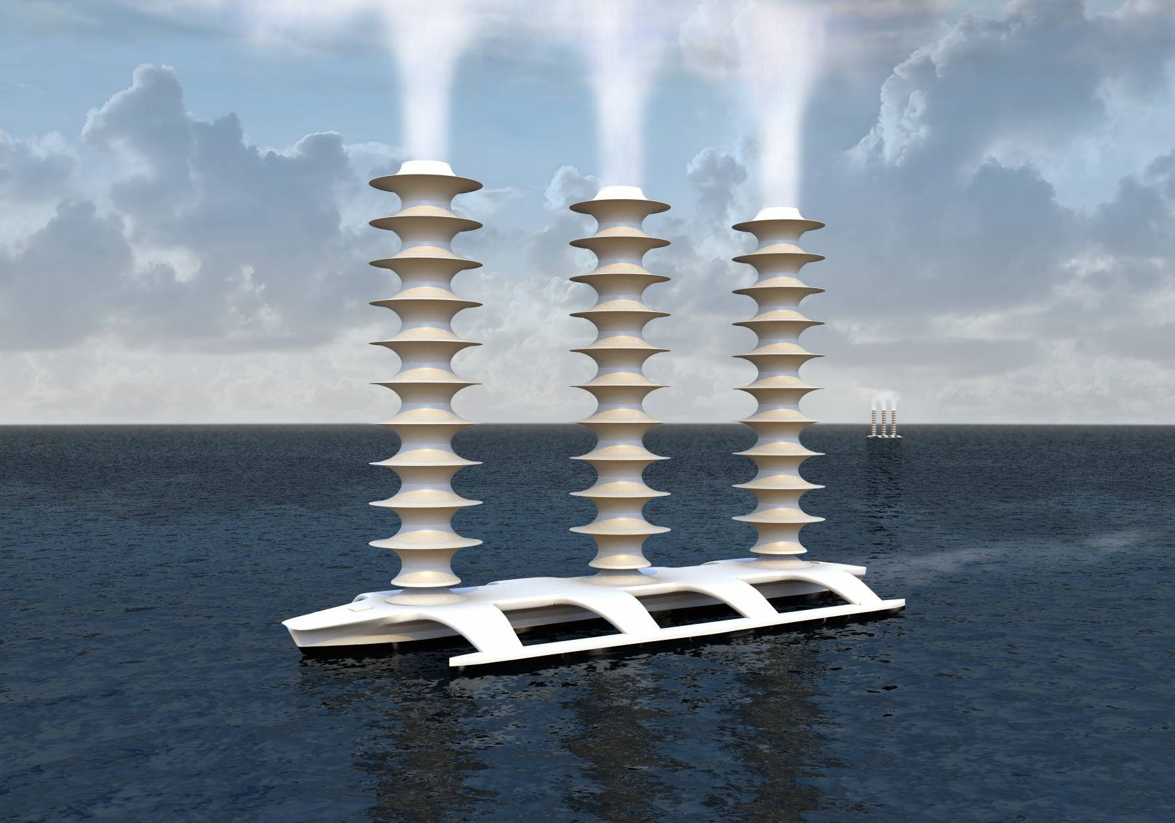
Cloud Seeding
This geo-engineering approach may be considered an analogue to Natural droplet creation at ocean surface

Slide 16
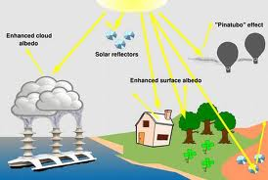
Solar Radiation Management
The other solar radiation management techniques include:
Painting rooftops white
Space mirrors

Slide 17

PROCESS OF DISPERSING CIRRUS CLOUDS

Slide 18
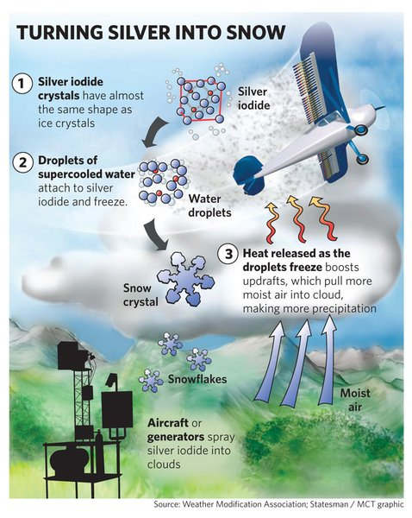
Plan: Spraying of Bismuth tri-iodide and silver iodide high in atmosphere
Advantages:
1.Availibility of bismuth salts.
2. Feasible
3.No reduction in rainfall.

Slide 19
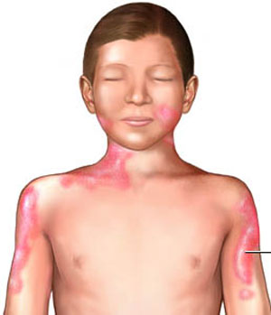
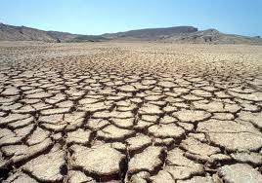
Disadvantages:-
1. Unclear to cool poles
2. Climate alteration
3. Cause soil pollution
4.Bismuth causes various disorders.
5.Cause of agryria.

Slide 20
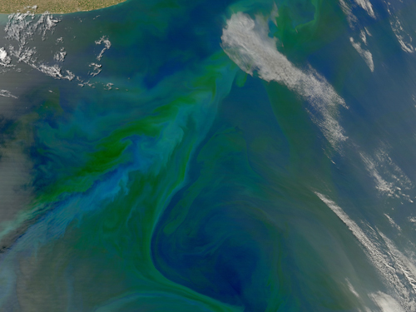
OCEAN FERTILISATION

Slide 21
Plan:-Boost the growth of plankton by adding nutrients
Advantages:-
Feeds the algae which absorbs CO2 and other toxic gases
Iron locks toxic gases
Benefit marine food chain
Enhance marine productivity

Slide 22
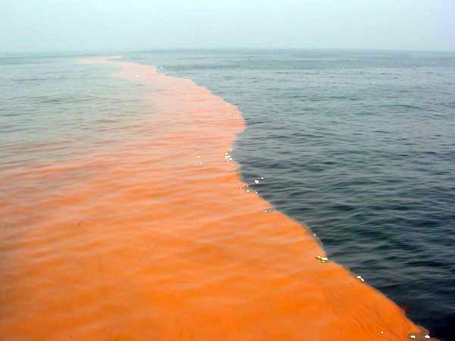
Disadvantages:-
1.Unwanted plankton growth
2. Non practicable techniques
3. Algae which give rise to red tides and toxic acids.
4. Oxygen deterioration.

Slide 23
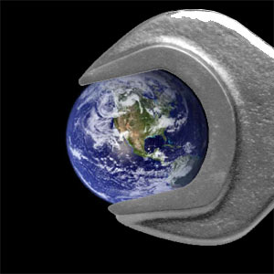

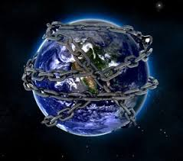
Conclusion

