Slide 1
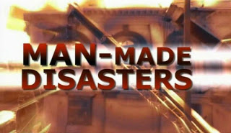
MAN MADE DISASTERS

Slide 2
PRESENTED BY
(GO GREEN GROUP):
VALLARI KOTHARI-1111108
HARSH MALDE-1111114
AKSHAY PAWAR-1221018

Slide 3
INTRODUCTION:
Anthropogenic hazards or human-made hazards can result in the form of a human-made disaster. In this case, anthropogenic means threats having an element of human intent, negligence, or error; or involving a failure of a human-made system. It results in huge loss of life and property. It further affects a person's mental, physical and social well-being. This is opposed to natural disasters resulting from natural hazards.

Slide 4
CONTENTS
BHOPAL GAS TRAGEDY
HIROSHIMA AND NAGASAKI ATOMIC BOMBING
DEEPWATER OIL SPILL-GULF OF MEXICO

Slide 5
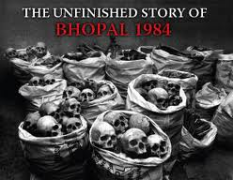
BHOPAL GAS TRAGEDY

Slide 6
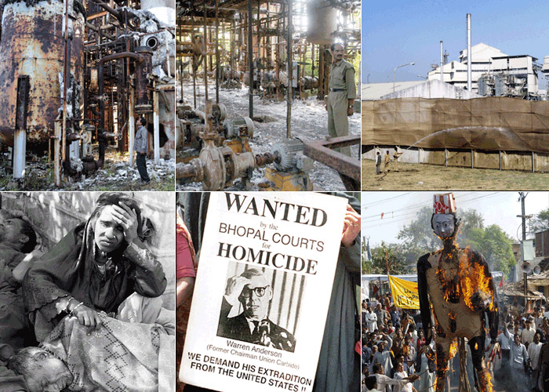
The Bhopal disaster, also referred to as the Bhopal gas tragedy, was a gas leak incident in India, considered the world's worst industrial disaster.
It occurred on the night of 2–3 December 1984 at the Union Carbide India Limited (UCIL) pesticide plant in Bhopal, Madhya Pradesh.

Slide 7
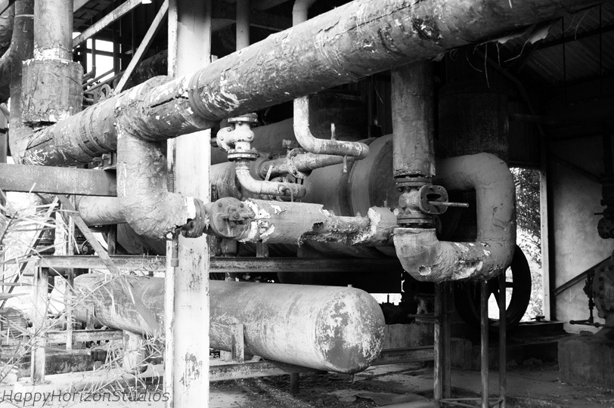
CAUSE:
Factors leading to the magnitude of the gas leak mainly included problems such as:
storing MIC in large tanks and filling beyond recommended levels
poor maintenance after the plant ceased MIC production at the end of 1984
failure of several safety systems due to poor maintenance
safety systems being switched off to save money.

Slide 8
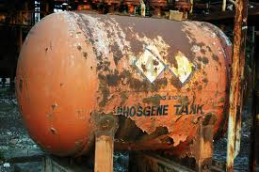
Other factors identified by the inquiry included: use of a more dangerous pesticide manufacturing method, large-scale MIC storage, plant location close to a densely populated area, undersized safety devices, and the dependence on manual operations.

Slide 9
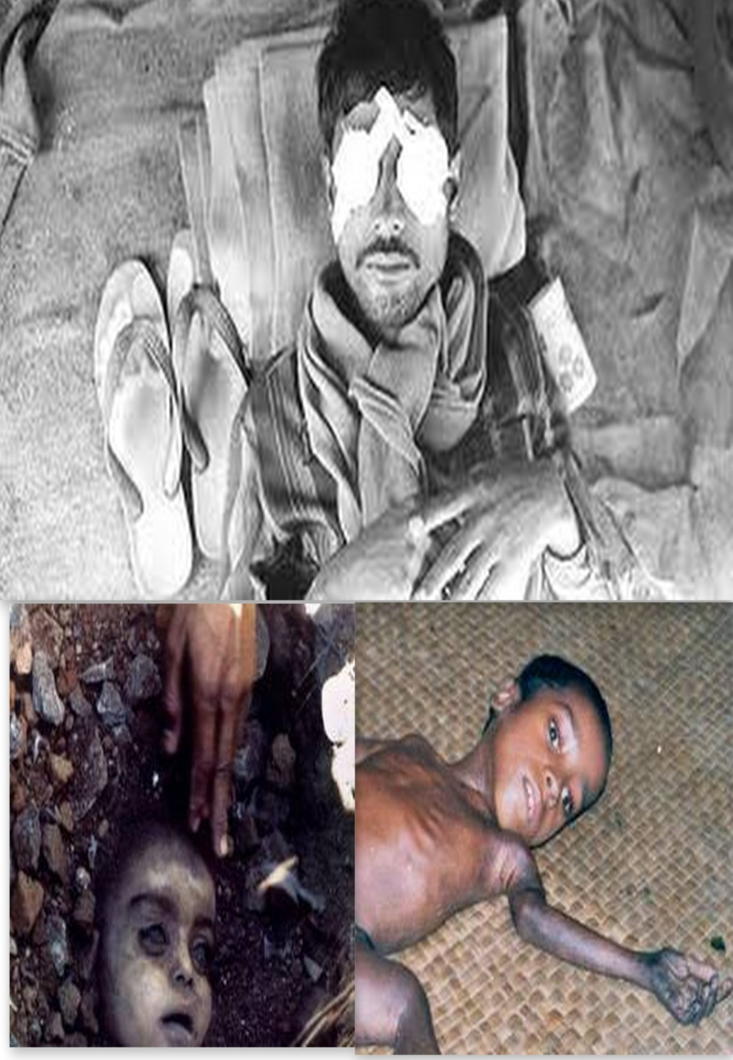
Effect:
Over 500,000 people were exposed to methyl isocyanate gas and other chemicals.
The government of Madhya Pradesh confirmed a total of 3,787 deaths related to the gas release. Others estimate 8,000 died within two weeks and another 8,000 or more have since died from gas-related diseases.

Slide 10
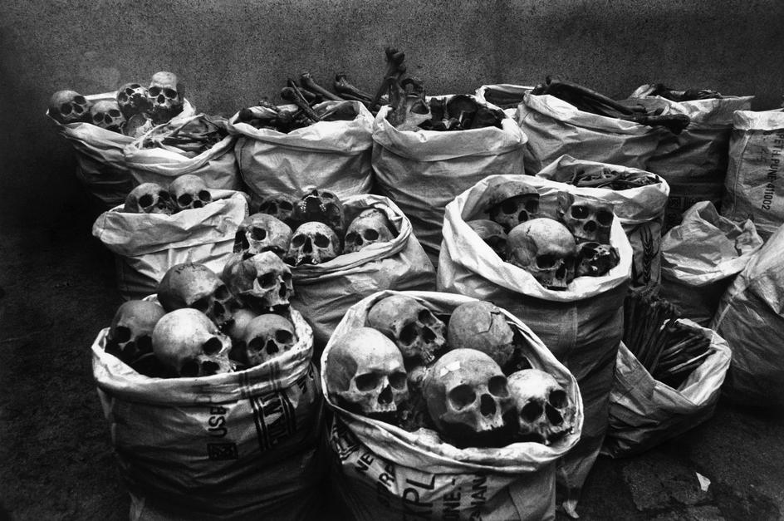

Slide 11
The initial effects of exposure were coughing, vomiting, severe eye irritation and a feeling of suffocation.
2,000 buffalo, goats, and other animals were collected and buried.
Within a few days, leaves on trees yellowed and fell off.
Fishing was prohibited causing further supply shortages.

Slide 12
GOVERNMENT MEASURES:
170,000 people were treated at hospitals and temporary dispensaries hospitals had been built after the disaster.
Provisions for 500-bed hospital for the medical care of the survivors.

Slide 13
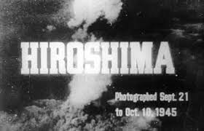
HIROSHIMA AND NAGASAKI

Slide 14
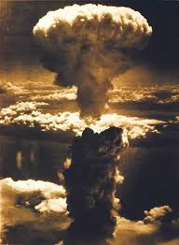
The atomic bombings of the cities of Hiroshima and Nagasaki in Japan were conducted by the United States during the final stages of World War II in 1945.
The two events are the only use of nuclear weapons in war to date.

Slide 15
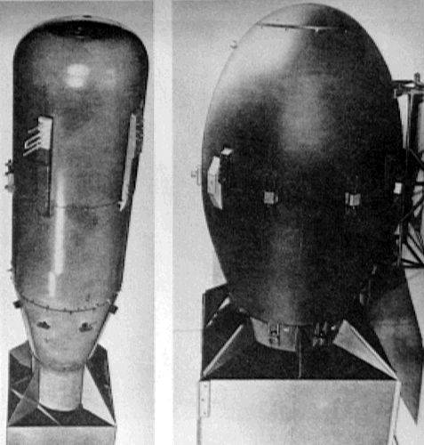
CAUSE:
Together with the United Kingdom and the Republic of China, the United States called for a surrender of Japan in the Potsdam Declaration on 26 July 1945, threatening Japan with "prompt and utter destruction".
The Japanese government ignored this ultimatum. American airmen dropped Little Boy on the city of Hiroshima on 6 August 1945, followed by Fat Man over Nagasaki on 9 August.

Slide 16
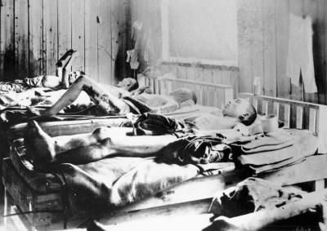
EFFECTS:
Within the first two to four months of the bombings, the acute effects killed 90,000–166,000 people in Hiroshima and 60,000–80,000 in Nagasaki, with roughly half of the deaths in each city occurring on the first day
60% died from flash or flame burns, 30% from falling debris and 10% from other causes.
Estimation by US-15–20% died from radiation sickness, 20–30% from burns, and 50–60% from other injuries, compounded by illness.

Slide 17
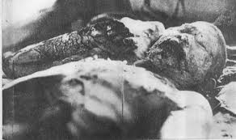
Large numbers died from the effect of burns, radiation sickness, and other injuries, compounded by illness.
Following the explosions, the materials irradiated by neutrons from the bomb, were carried high into the atmosphere resulting into “black rain”.
This “black rain” reached ground level as sticky, dark, dangerously radioactive water. It not only stained skin, clothing, and buildings, but also was ingested by breathing and by consumption of contaminated food or water, causing radiation poisoning.

Slide 18
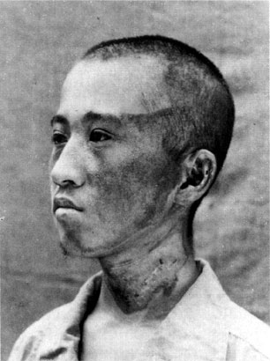
EFFECTS TILL DATE:
Around 1,900 cancer deaths can be attributed to the after-effects of the bombs.
46% of leukemia deaths and 11% of solid cancer deaths among the bomb survivors were due to radiation from the bombs.
There are very few people who still suffer from the effects of the radiation from the bombs. They have grown from being completely flattened, to having almost 1 million people living in each city today.

Slide 19
GOVERNMENT MEASURES
Japan had no means to reconstruct the country so US took 15 years to reconstruct it.
The national government in November 1945 adopted a “war disaster reconstruction plan” for rebuilding 119 war-devastated cities, including Hiroshima and Nagasaki.

Slide 20
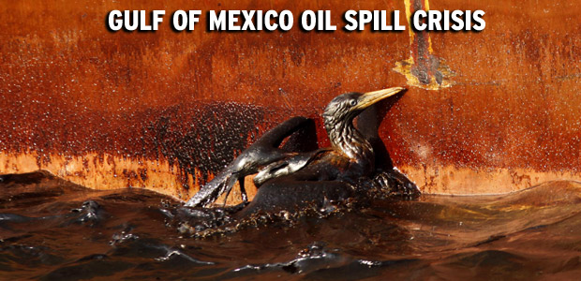
DEEPWATER OIL SPILL-MEXICO

Slide 21
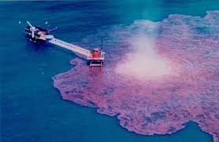
The Deepwater Horizon oil spill (also referred to as the BP oil spill, the BP oil disaster, the Gulf of Mexico oil spill, and the Macondo blowout) was an oil spill in the Gulf of Mexico.
It is considered the largest accidental marine oil spill in the history of the petroleum industry.
Estimated to be between 8% and 31% larger in volume than the earlier.

Slide 22
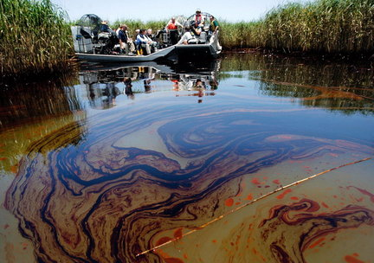
Cause:
On 20 April 2010, high-pressure methane gas from the well expanded into the drilling riser and rose into the drilling rig, where it ignited and exploded, engulfing the platform.
At high pressures, some of the natural gas separated from the oil within the hydrocarbon stream and ignited causing the explosion.

Slide 23
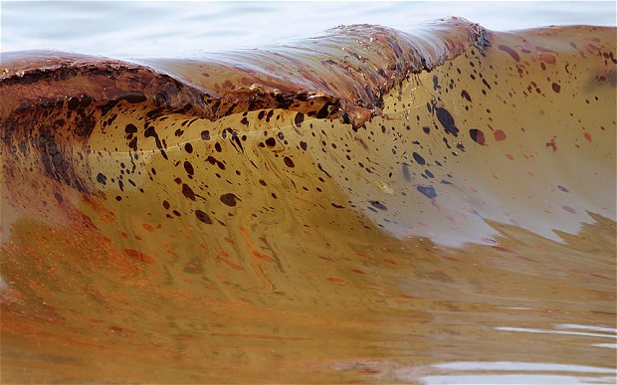
EFFECT:
The total discharge is estimated at 4.9 million barrels (210 million US gal; 780,000 m³).
Extensive damage to marine and wildlife habitats, fishing and tourism industries, and human health problems have continued through 2013.
Eleven workers were never found despite a three-day Coast Guard (USCG) search operation and are believed to have died in the explosion

Slide 24
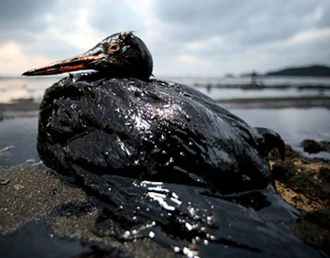
Effect till date
Three years after the spill, tar balls could still be found on the Mississippi coast.
The spill area hosted 8,332 species, including more than 1,200 fish, 200 birds, 1,400 mollusks, 1,500 crustaceans, 4 sea turtles and 29 marine mammals

Slide 25
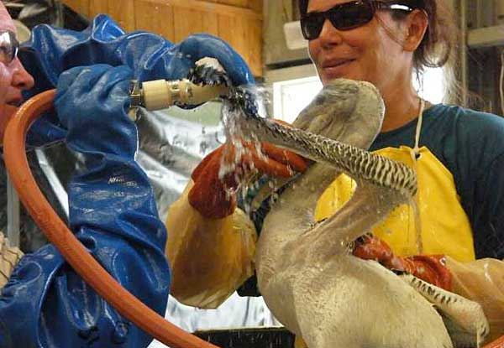
MEASURES:
NGO’s and private parties all get actively involved in response and clean up procedures.
Humans were not allowed near ocean waters.
Each of the species were given water, food, and were cleaned to evaluate their reaction and behavior.
BP worked with wildlife agencies to figure out the locations of releasing and returning wildlife along the Gulf Coast that went through rehabilitation

Slide 26
