Slide 1

The Pollution Within

Slide 2
Overview
The Definition
Genetic Engineering
Invasive Species
Controversial Term
Back Breeding
Genetic Erosion

Slide 3
The Definition
A controversial term for uncontrolled
Gene flow into Wild Populations .
This is undesirable according to groups such as “Greenpeace” & “TRAFFIC”.

Slide 4
Controversial Term
Genetic Deterioration
Genetic Aggression
Genetic Mixing
Pre-Historic Concept

Slide 5
Back Breeding
Artificial or Selective Breeding
Extinct Animals
Conservation Biology
Examples

Slide 6
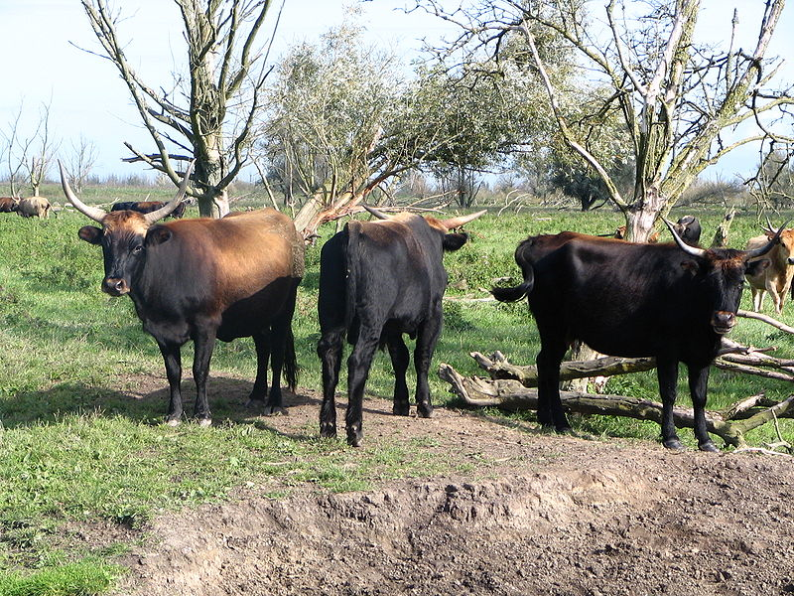
Breeding Back
(Heck Cattle Group in Netherlands)

Slide 7
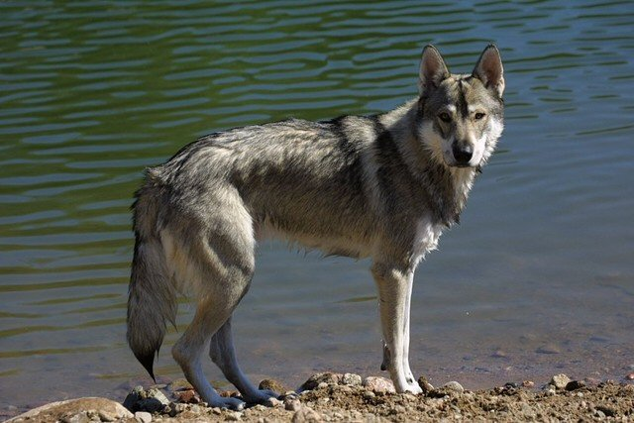
Breeding Back
(Tamaskan Dog bred to resemble the Wolf in phenotype)

Slide 8
Genetic Erosion & Pollution Assessment Methodologies
Objectives :
Agree genetic erosion and pollution assessment methodologies for CWR. (Crop Wild Relatives)
To assess and predict genetic erosion.

Slide 9
Prioritization - Which taxa do we assess in detail?
We have to highlight the taxa where more detailed assessment of genetic erosion/pollution and subsequent monitoring is needed.
The Red List threat category could be a determining factor in choosing the level of assessment of genetic erosion/pollution.

Slide 10
Session 1
( Presentations and
Discussions ) :
Political and legal issues.
Genetic erosion.
Genetic pollution.

Slide 11
Session 2
( Monitoring ):
Monitoring at the taxonomic level.
Monitoring at the population level.
Monitoring at the gene level.

Slide 12
Session 3
( Case Studies ):
Agricultural crops.
Horticultural crops.
Forestry.
  Any special cases to consider ?
  Any specific examples ?
  Any special needs ?

Slide 13
Thank You !
A Presentation by
Darshan Gajara (1111118)
Rohan Thakkar (1111076)
Pallavi Bhoite (1011077)

