Slide 1
Operating system
Priyanka Thakkar
Rhythm Shah
Rohan Thakkar
Sarvesh Kapre
Shardul Mahadik

Slide 2

What Is It?
It is the first program to be loaded on boot.
It is a software that acts as a bridge between the hardware and the applications .
Manages the hardware and software resources of the system.
Provides a stable consistent way for applications to deal with the hardware without having to know all the details of the hardware.

Slide 3
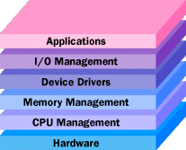
What Does It Do?
Ensures that all the applications get the necessary resources.
Manages input and output.
Helps the developer to make applications compatible with many systems.
Keeping track of the files and directories on the disk.
Controlling peripheral devices such as disk drives, printers and scanners.

Slide 4
How Is It Classified?
Operating System
Real-Time operating system
Single-user, single task
Single-user, multi-tasking
Multi-user
Based on Applications
Based on Targeted Devices
Desktop
Mobile

Slide 5
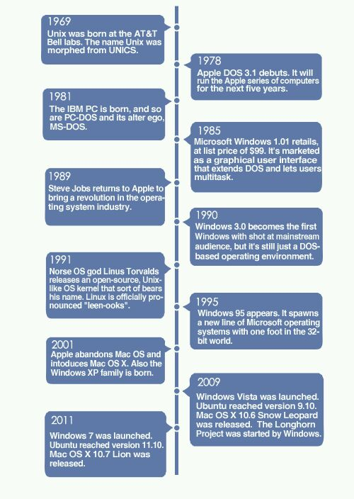
Timeline

Slide 6
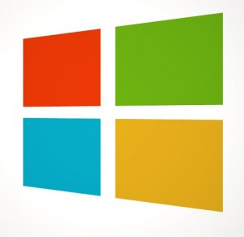

Windows
Released on November 20, 1985 by
Microsoft.
Developed by Paul Allen and Bill Gates.
Graphical User Interface
Over 80% market share in the home environment.
Revolutionized the world by introducing personal computing.
DID YOU KNOW?
Vista sold 20 million copies within its first month

Slide 7
History Of Windows
1975: Microsoft Boots Up
1982: Introducing Windows 1.0
1990: Windows 3.0 - Getting the graphics
1995: Windows 95 – the age of PC and the Internet
2001: Windows XP - Stable, Usable and Fast
2006: Windows Vista - Smart on security
2009: Windows 7 and counting...
DID YOU KNOW?
You can’t create a folder called ‘con’ in Windows!

Slide 8
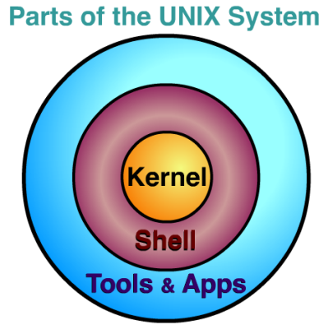
Unix
Developed in 1969 by a group of AT&T employees at Bell Labs, including Ken Thompson, Dennis Ritchie
Designed to be portable, multi-tasking and multi-user in a time-sharing configuration.
A self-contained software system.
Easy to adopt and move to
different machines.
DID YOU KNOW?
UNIX systems cannot set a date prior to 1 Jan,1970!

Slide 9

Linux
Launched on 5 October 1991 by Linus Torvalds.
Free and open source software.
Highly secure with no viruses.
Runs on a highly diverse range of devices ranging from mobile phones to supercomputers.
Used in 90% of world’s fastest supercomputers i.e. the TOP 500.
DID YOU KNOW?
The latest Linux kernel has over 10 million lines of code!

Slide 10
Linux
Android is based on a modified version of the
Linux kernel.
Power to modify almost anything in the system files.
Kerala has mandated that all state high schools run Linux on their computers.
Interesting naming convention starting with version 5.10 Breezy Badger going up alphabetically to 12.10 Quantal Quetzal.

Slide 11
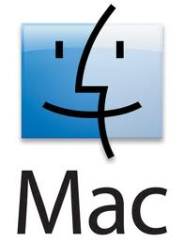
Macintosh
Launched in 1999 as Mac OS X Server 1.0
First release was Public Beta on 13 Sept,2000.
Main reasons for criticisms were
Interface
Stability
Missing Features and Hardware Compatibility
OS X Mountain Lion was released on July 25, 2012 with new features such as
Notification Centre
Application Update
Game Centre
DID YOU KNOW?
The original Apple logo had Isaac Newton sitting under an apple tree.

Slide 12
Comparison
PROPERTIES | MAC | WINDOWS | LINUX
Security | Good | Poor | Excellent
Cost | High | Moderate | Free
Popularity | Moderate | High | Moderate
Ease of Use | Moderate | Highest | Poor
Targeted | Designing | Home Use | Servers
Flexibility | Moderate | Low | Highest

Slide 13
Statistics

Slide 14
What’s Happening?
Touchscreen support introduced in Windows 8
Linux user interface made easier with the GNOME shell.
Ubuntu Linux introduces 7 second boot.
Mac OS X 10.8 offers social network integration with Facebook and Twitter.

Slide 15
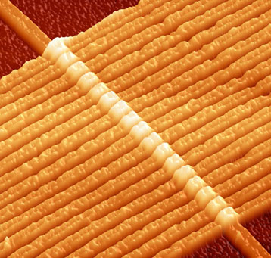
What comes next?
Cloud Boots
Developed by Apple.
Files are stored in the cloud.
Memristor
HP has created the first prototype of a working “memristor”.
Booting time will be unimaginably short—we’re talking 0.35 seconds.
High-storage capacities at 100 gigabits per cm sq. and about 1 petabit per cm cu.

Slide 16
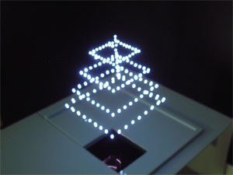
What comes next?
Two in One
CPU and GPU are combined
Displaying 3D in Air
Speed of GPU is 20 times that of the CPU.
Laser produced plasma technology used to produce flashpoints in air.
First successful project is on at AIST, Japan.
Semantic Desktop
Searches and interlinks the files
with various other objects on
the system.

