Slide 1


Slide 2

By-
ASLAM KHAN (1221013)
SHALAKA WAGH (1221014)
TULIKA HARSULKAR (1221016)
BHAKTI MAHADIK (1221017)
AKSHAY PATIL(1221019)
ASMITA MORE (1221020)
{ S.E COMPUTER RNGINEERING
K.JSOMAIYA COLLEGE OF
ENGINEERING }

Slide 3

HIGHLIGHTS
What is hacking?
Is hacking a crime?
Hacking Vs Cracking
Types of hackers
Case study
Security
Flashback

Slide 4

Ethical Hacking is testing the resources for a good cause and for the
betterment of technology.
Technically Ethical Hacking means penetration
testing which is focused on Securing and Protecting IT Systems.
What is Ethical Hacking??

Slide 5

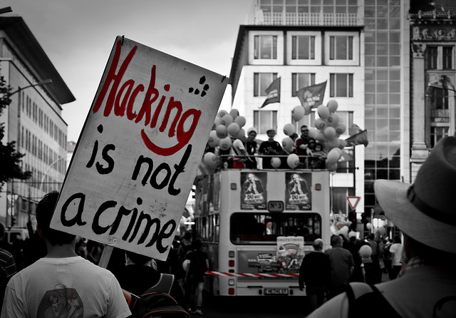
Is hacking a crime??
NO NO NO..
NOT AT ALL…….
Hacking is NOT a
CRIME

Slide 6

Hacker is a word that has two
meanings:
Traditionally, a Hacker is
someone who likes to play with
Software or Electronic Systems.
Recently, Hacker has taken on a
new meaning — someone who
maliciously breaks into systems for
personal gain. Technically, these
criminals & are known as Crackers.
H4ck3r

Slide 7

H4CKING VS CR4CKING
HACKING WITH MALICIOUS INTENTION IS CRACKING
The basic difference is hackers do not do anything disastrous.
Cracking yield more devastating results.
Cracking is crime.
Cyber crime are the results of cracking ,not hacking

Slide 8

Why Ethical H4cking!?
It is Legal
Permission is obtained from the target
Part of an overall security program
Identify vulnerabilities visible from Internet at
particular point of time
Ethical hackers possesses same skills, mindset
and tools of a hacker but the attacks are done in
a non-destructive manner

Slide 9
Types of H4cker$
Distinction on the basis of knowladge
CODERS
ADMINS
SCRIPT KIDDIES
Distinction on the basis of LEGALITY
WHITE HATS
GREY HATS
BLACK HATS

Slide 10
COD3RS=
Have full knowladge.
They know what exactly they are doing
Well aware about the different codes
Have complete idea what is going beyond coding.
H4ck3r at work

Slide 11

ADMINS
Knows what they are doing.
They don’t have idea that what exactly going beyond codes.
Result oriented persons
They are not so harmful.

Slide 12

SCRIPT KIDDIES
Script kiddies or packet monkeys
  Young in-experienced hackers
  Copy codes and techniques from knowledgeable hackers .
  Don’t know what’s going beyond the coding.
  Use techniques for fun purpose.
  Sometimes could be very dangerous for the system,

Slide 13
WHITE HATS
These are good hackers .
Have genuine license to hack.
Have registered police records
Evolves themselves in good works
Generally owned by companies for security designing
Have high pay scales.
Generally these are coders

Slide 14
BLACK HATS
very dangerous persons.
Always have motive to earn huge profit.
Highly paid persons.
Evolves themselves mostly in criminal activities.
These could be coders, admins as well as script kiddies

Slide 15
GREY HATS
Also known as red hats.
Perform both tasks fair as well as unfair.
Generally these are admins.
Have little high pay than white hats.
Generally not so dangerous, but sometimes could be.

Slide 16
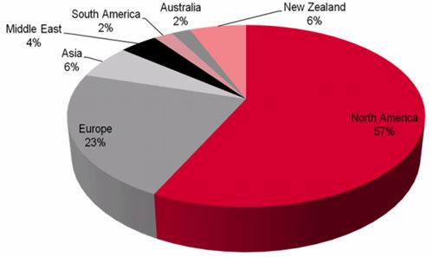
Case Study
H4cking prone areas

Slide 17
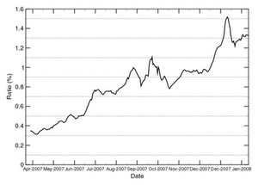
Case Study(contd..)
H4cking growth rate
It is clear from the graph it is increasing day by day.

Slide 18

Security & Counter Measures
Use of anti-viruses.
Proper logout after use of mail id.
Manual opening browser
don't open spam.
Password protected admin account.

Slide 19


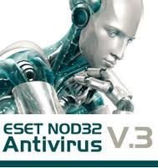






Anti viruses

Slide 20
H4ck3r$
Famous hackers all over D world
Nahshon Even-Chaim (born May 1971), was the first major computer hacker
Stewert Nelson from America followed Nehshon in 1972
Ankit Phadia from India is also a well known name in hackers history
Abdur zahir from Pakistan has also a good name in this world

Slide 21
Flashback
HACKING IS USING AN AUTHORISE THING IN A UN AUTHORISED MANNER
HACKIING IS ILLEGAL BUT NOT A CRIME.
TYPES OF HACKERS.
VIRUSES ,WORMS & TROJANS.
ADMIN PASSWORD HACKING

Slide 22
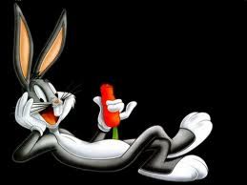
Dat’s all folks

Slide 23
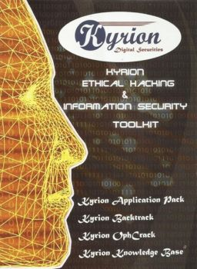
REFERENCES
KYRION DIGITAL SECURITIES
WIKIPEDIA
GOOGLE
BING.COM
BLOGSPOT.COM

Slide 24

THANK U..

